Slide 1
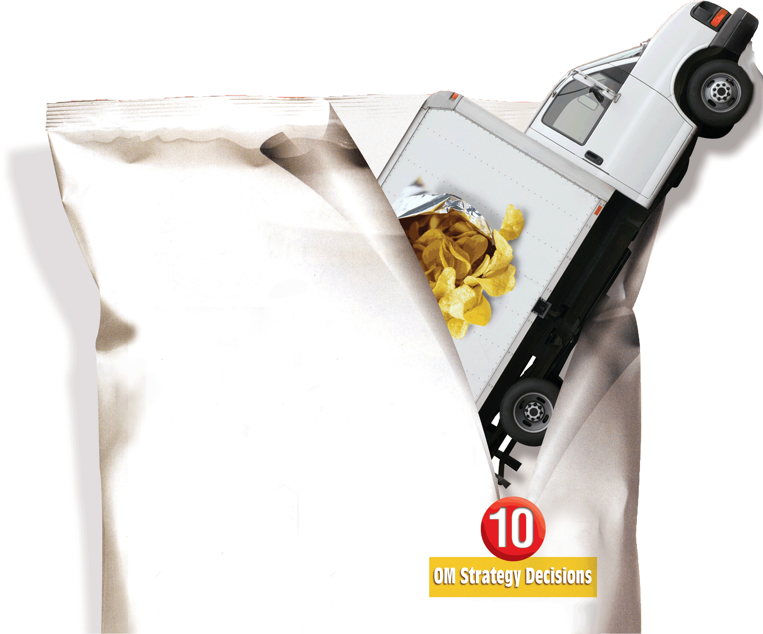
11
Supply-Chain Management
PowerPoint presentation to accompany
Heizer and Render
Operations Management, 10e
Principles of Operations Management, 8e
PowerPoint slides by Jeff Heyl

Slide 2
Outline
Global Company Profile:
Darden Restaurants
The Supply Chain’s Strategic Importance
  Supply Chain Risk
Ethics and Sustainability
Supply-Chain Economics
  Make-or-Buy Decisions
  Outsourcing

Slide 3
Outline – Continued
Supply-Chain Strategies
  Many Suppliers
  Few Suppliers
  Vertical Integration
  Joint Ventures
  Keiretsu Networks
  Virtual Companies

Slide 4
Outline – Continued
Managing the Supply Chain
  Issues in an Integrated Supply Chain
  Opportunities in an Integrated Supply Chain
E-Procurement
  Online Catalogs
  Auctions
  RFQs
  Realtime Inventory Tracking

Slide 5
Outline – Continued
Vendor Selection
  Vendor Evaluation
  Vendor Development
  Negotiations

Slide 6
Outline – Continued
Logistics Management
  Distribution Systems
  Third-Party Logistics
  Cost of Shipping Alternatives
  Security and JIT
Measuring Supply-Chain Performance

Slide 7
Learning Objectives
When you complete this chapter you should be able to:
Explain the strategic importance of the supply chain
Identify six supply-chain strategies
Explain issues and opportunities in the supply chain
Describe the steps in vendor selection

Slide 8
Learning Objectives
When you complete this chapter you should be able to:
Explain major issues in logistics management
Compute percent of assets committed to inventory and inventory turnover

Slide 9
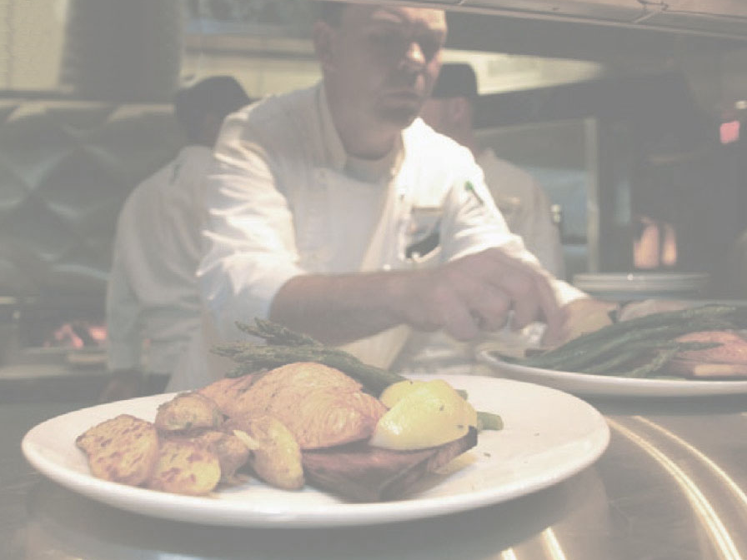
Darden Restaurants
Largest publicly traded casual dining company in the world
Serves over 400 million meals annually in more than 1,800 restaurants in the US and Canada
Annual sales of $6.7 billion
Operations is the strategy

Slide 10
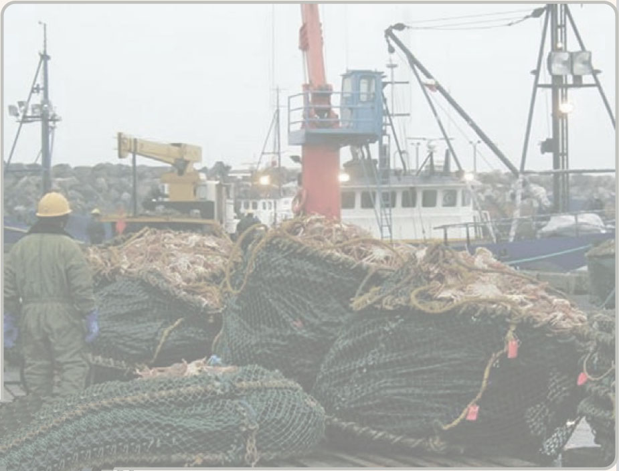
Darden Restaurants
Sources food from five continents and thousands of suppliers
Four distinct supply chains
Over $1.5 billion spent annually in supply chains
Competitive advantage achieved through superior supply chain

Slide 11
Supply-Chain Management
The objective is to build a chain of suppliers that focuses on maximizing value to the ultimate customer

Slide 12
The Supply Chain’s Strategic Importance
Supply chain management is the integration of the activities that procure materials and services, transform them into intermediate goods and final products, and deliver them through a distribution system
Competition is no longer between companies; it is between supply chains

Slide 13
Supply Chain Management
Important activities include determining
Transportation vendors
Credit and cash transfers
Suppliers
Distributors
Accounts payable and receivable
Warehousing and inventory
Order fulfillment
Sharing customer, forecasting, and production information

Slide 14
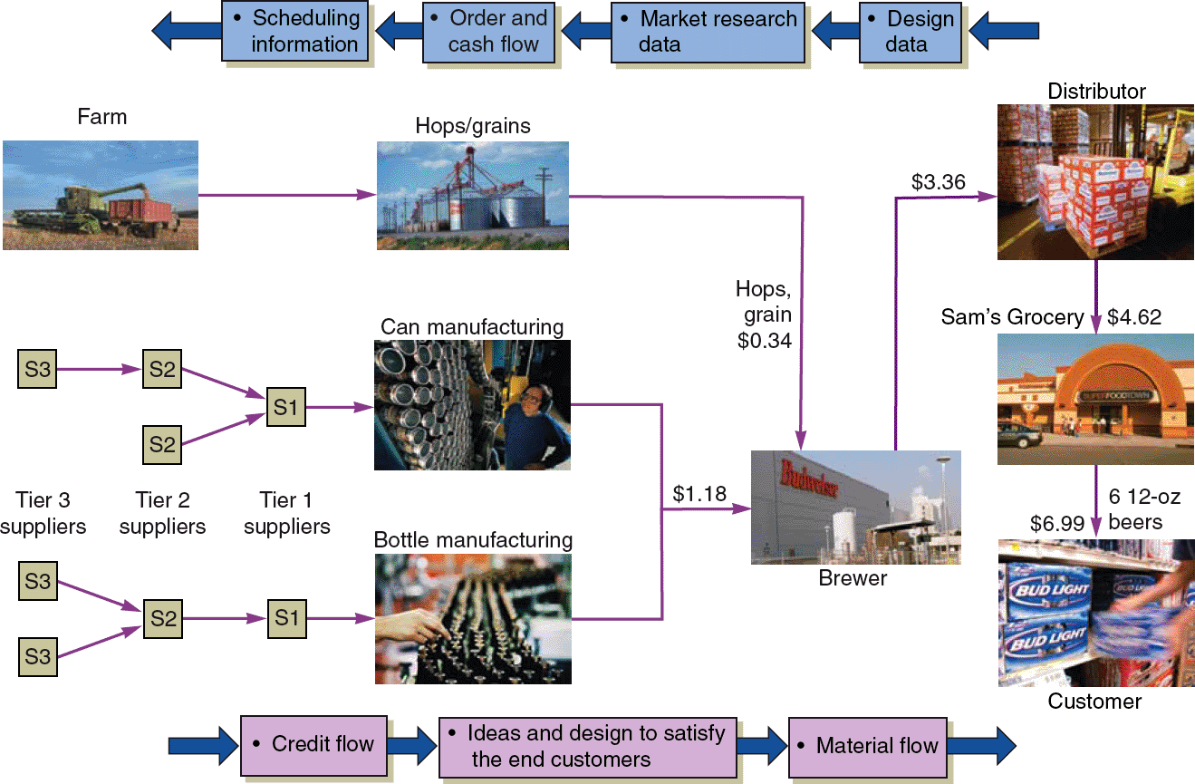
A Supply Chain for Beer
Figure 11.1

Slide 15
How Supply Chain Decisions Impact Strategy
 | Low-Cost Strategy | Response Strategy | Differentiation Strategy
Supplier’s goal | Supply demand at lowest possible cost (e.g., Emerson Electric, Taco Bell) | Respond quickly to changing requirements and demand to minimize stockouts (e.g., Dell Computers) | Share market research; jointly develop products and options (e.g., Benetton)
Primary selection criteria | Select primarily for cost | Select primarily for capacity, speed, and flexibility | Select primarily for product development skills
Table 11.1

Slide 16
How Supply Chain Decisions Impact Strategy
 | Low-Cost Strategy | Response Strategy | Differentiation Strategy
Process charact-eristics | Maintain high average utilization | Invest in excess capacity and flexible processes | Modular processes that lend themselves to mass customization
Inventory charact-eristics | Minimize inventory throughout the chain to hold down cost | Develop responsive system with buffer stocks positioned to ensure supply | Minimize inventory in the chain to avoid obsolescence
Table 11.1

Slide 17
How Supply Chain Decisions Impact Strategy
 | Low-Cost Strategy | Response Strategy | Differentiation Strategy
Lead-time charact-eristics | Shorten lead time as long as it does not increase costs | Invest aggressively to reduce production lead time | Invest aggressively to reduce development lead time
Product-design charact-eristics | Maximize performance and minimize costs | Use product designs that lead to low setup time and rapid production ramp-up | Use modular design to postpone product differentiation as long as possible
Table 11.1

Slide 18
Supply Chain Risk
More reliance on supply chains means more risk
Fewer suppliers increase dependence
Compounded by globalization and logistical complexity
Vendor reliability and quality risks
Political and currency risks

Slide 19
Supply Chain Risk
Mitigate and react to disruptions in
  Processes
  Controls
  Environment

Slide 20
Supply Chain Risk
Reducing risk in supply chains
  Process risk at McDonald’s
  Process risk at Ford
  Controls at Darden Restaurants
  Control risk at Boeing
  Environmental risk at Hard Rock Café
  Environmental risk at Toyota

Slide 21
Ethics and Sustainability
Personal ethics
  Institute for Supply Management Principles and Standards
Ethics within the supply chain
Ethical behavior regarding the environment

Slide 22
Principles and Standards for Ethical Supply Management Conduct
LOYALTY TO YOUR ORGANIZATION
JUSTICE TO THOSE WITH WHOM YOU DEAL
FAITH IN YOUR PROFESSION
Table 11.2

Slide 23
Principles and Standards for Ethical Supply Management Conduct
PERCEIVED IMPROPRIETY Prevent the intent and appearance of unethical or compromising conduct in relationships, actions and communications
CONFLICTS OF INTEREST Ensure that any personal, business or other activity does not conflict with the lawful interests of your employer
ISSUES OF INFLUENCE Avoid behaviors or actions that may negatively influence, or appear to influence, supply management decisions
Table 11.2

Slide 24
Principles and Standards for Ethical Supply Management Conduct
RESPONSIBILITIES TO YOUR EMPLOYER Uphold fiduciary and other responsibilities using reasonable care and granted authority to deliver value to your employer
SUPPLIER AND CUSTOMER RELATIONSHIPS Promote positive supplier and customer relationships
SUSTAINABILITY AND SOCIAL RESPONSIBILITY Champion social responsibility and sustainability practices in supply management
Table 11.2

Slide 25
Principles and Standards for Ethical Supply Management Conduct
CONFIDENTIAL AND PROPRIETARY INFORMATION Protect confidential and proprietary information
RECIPROCITY Avoid improper reciprocal agreements
APPLICABLE LAWS, REGULATIONS AND TRADE AGREEMENTS Know and obey the letter and spirit of laws, regulations and trade agreements applicable to supply management
Table 11.2

Slide 26
Principles and Standards for Ethical Supply Management Conduct
PROFESSIONAL COMPETENCE Develop skills, expand knowledge and conduct business that demonstrates competence and promotes the supply management profession
Table 11.2

Slide 27
Supply Chain Economics
Supply Chain Costs as a Percent of Sales
Industry | % Purchased
All industry | 52
Automobile | 67
Food | 60
Lumber | 61
Paper | 55
Petroleum | 79
Transportation | 62
Table 11.3

Slide 28
Supply Chain Economics
Dollars of additional sales needed to equal $1 saved through the supply chain
Percent of Sales Spent in the Supply Chain
Percent Net Profit
of Firm 30% 40% 50% 60% 70% 80% 90%
2 $2.78 $3.23 $3.85 $4.76 $6.25 $9.09 $16.67
4 $2.70 $3.13 $3.70 $4.55 $5.88 $8.33 $14.29
6 $2.63 $3.03 $3.57 $4.35 $5.56 $7.69 $12.50
8 $2.56 $2.94 $3.45 $4.17 $5.26 $7.14 $11.11
10 $2.50 $2.86 $3.33 $4.00 $5.00 $6.67 $10.00
Table 11.4

Slide 29
Make-or-Buy Decisions
Choice between internal production and external sources

Slide 30
Outsourcing
Transfers traditional internal activities and resources of a firm to outside vendors
Utilizes the efficiency that comes with specialization
Firms outsource information technology, accounting, legal, logistics, and production

Slide 31
Supply Chain Strategies
Negotiating with many suppliers
Long-term partnering with few suppliers
Vertical integration
Joint ventures
Keiretsu
Virtual companies that use suppliers on an as needed basis

Slide 32
Many Suppliers
Commonly used for commodity products
Purchasing is typically based on price
Suppliers compete with one another
Supplier is responsible for technology, expertise, forecasting, cost, quality, and delivery

Slide 33
Few Suppliers
Buyer forms longer term relationships with fewer suppliers
Create value through economies of scale and learning curve improvements
Suppliers more willing to participate in JIT programs and contribute design and technological expertise
Cost of changing suppliers is huge

Slide 34
Vertical Integration
Vertical Integration Examples of Vertical Integration
Raw material (suppliers) | Iron ore | Silicon | Farming
Backward integration | Steel
Current transformation | Automobiles | Integrated circuits | Flour milling
Forward integration | Distribution systems | Circuit boards
Finished goods (customers) | Dealers | Computers Watches Calculators | Baked goods
Figure 11.2

Slide 35
Vertical Integration
Developing the ability to produce goods or service previously purchased
Integration may be forward, towards the customer, or backward, towards suppliers
Can improve cost, quality, and inventory but requires capital, managerial skills, and demand
Risky in industries with rapid technological change

Slide 36
Joint Ventures
Formal collaboration
  Enhance skills
  Secure supply
  Reduce costs
Cooperation without diluting brand or conceding competitive advantage

Slide 37
Keiretsu Networks
A middle ground between few suppliers and vertical integration
Supplier becomes part of the company coalition
Often provide financial support for suppliers through ownership or loans
Members expect long-term relationships and provide technical expertise and stable deliveries
May extend through several levels of the supply chain

Slide 38
Virtual Companies
Rely on a variety of supplier relationships to provide services on demand
Fluid organizational boundaries that allow the creation of unique enterprises to meet changing market demands
Exceptionally lean performance, low capital investment, flexibility, and speed

Slide 39
Managing the Supply Chain
There are significant management issues in controlling a supply chain involving many independent organizations
Mutual agreement on goals
Trust
Compatible organizational cultures

Slide 40
Issues in an Integrated Supply Chain
Local optimization - focusing on local profit or cost minimization based on limited knowledge
Incentives (sales incentives, quantity discounts, quotas, and promotions) - push merchandise prior to sale
Large lots - low unit cost but do not reflect sales
  Bullwhip effect - stable demand becomes lumpy orders through the supply chain

Slide 41
Opportunities in an Integrated Supply Chain
Accurate “pull” data
Lot size reduction
Single stage control of replenishment
Vendor managed inventory (VMI)

Slide 42
Opportunities in an Integrated Supply Chain
Collaborative planning, forecasting, and replenishment (CPFR)
Blanket orders
Standardization

Slide 43
Opportunities in an Integrated Supply Chain
Postponement
Drop shipping and special packaging
Pass-through facility
Channel assembly

Slide 44
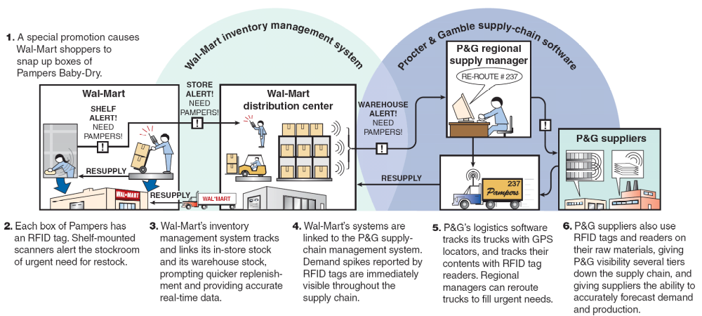
Radio Frequency Tags
Radio Frequency Tags: Keeping the Shelves Stocked
Supply chains work smoothly when sales are steady, but often break down when confronted by a sudden surge in demand. Radio frequency ID (or RFID) tags can change that by providing real-time information about what’s happening on store shelves. Here’s how the system works for Proctor & Gamble’s Pampers.

Slide 45
E-Procurement
Uses the internet to facilitate purchasing
Electronic ordering and funds transfer
  Electronic data interchange (EDI)
  Advanced shipping notice

Slide 46
E-Procurement
Online catalogs
  Catalogs provided by vendors
  Catalogs published by intermediaries
  Exchanges provided by buyers

Slide 47
Internet Trading Exchanges
Health care products – ghx.com
Retail goods – gnx.com
Defense and aerospace products – exostar.com
Food, beverage, consumer products – transora.com
Steel and metal products – metalsite.com
Hotels – avendra.com

Slide 48
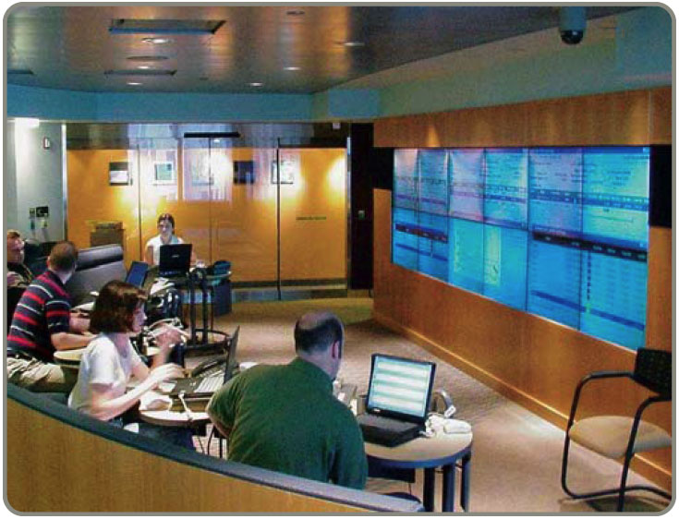
E-Procurement
Auctions
  Maintained by buyers, sellers, or intermediaries
  Low barriers
  to entry
  Increase in
  the potential
  number of
  buyers

Slide 49
E-Procurement
RFQs
  Can make requests for quotes (RFQs) less costly
  Improves supplier selection
Real-time inventory tracking

Slide 50
Vendor Selection
Vendor evaluation
  Critical decision
  Find potential vendors
  Determine the likelihood of them becoming good suppliers
Vendor Development
  Training
  Engineering and production help
  Establish policies and procedures

Slide 51
Vendor Evaluation
Criteria | Weights | Scores (1-5) | Weight x Score
Engineering/research/innovation skills | .20 | 5 | 1.0
Production process capability (flexibility/technical assistance) | .15 | 4 | .6
Distribution/delivery capability | .05 | 4 | .2
Quality systems and performance | .10 | 2 | .2
Facilities/location | .05 | 2 | .1
Financial and managerial strength (stability and cost structure) | .15 | 4 | .6
Information systems capability (e-procurement, ERP) | .10 | 2 | .2
Integrity (environmental compliance/ ethics) | .20 | 5 | 1.0
Total | 1.00 |  | 3.9

Slide 52
Vendor Selection
Negotiations
  Cost-Based Price Model - supplier opens books to purchaser
  Market-Based Price Model - price based on published, auction, or indexed price
  Competitive Bidding - used for infrequent purchases but may make establishing long-term relationships difficult

Slide 53
Logistics Management
Objective is to obtain efficient operations through the integration of all material acquisition, movement, and storage activities
Is a frequent candidate for outsourcing
Allows competitive advantage to be gained through reduced costs and improved customer service

Slide 54
Distribution Systems
Trucking
  Moves the vast majority of manufactured goods
  Chief advantage is flexibility
Railroads
  Capable of carrying large loads
  Little flexibility though containers and piggybacking have helped with this

Slide 55
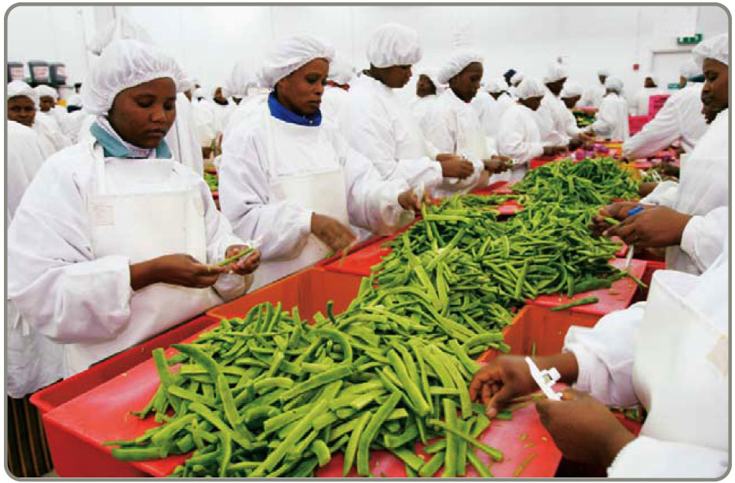
Distribution Systems
Airfreight
  Fast and flexible for light loads
  May be expensive

Slide 56
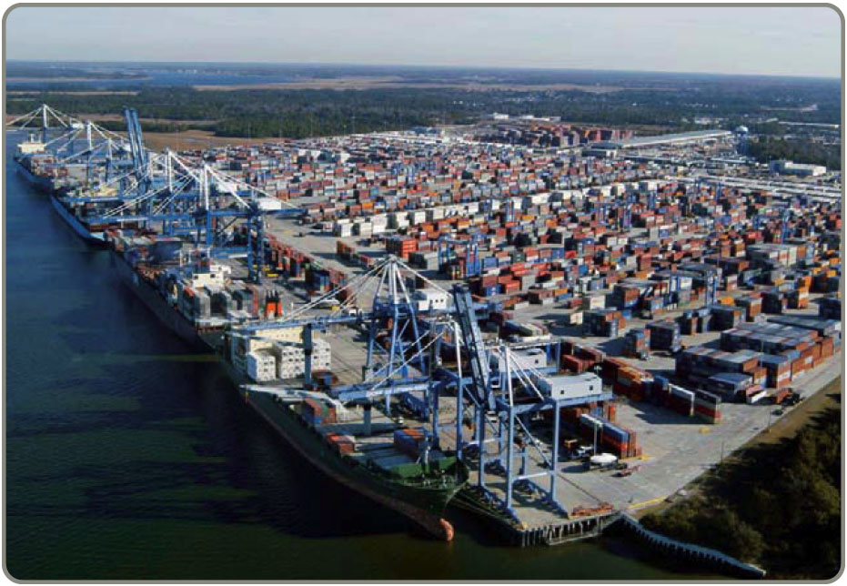
Distribution Systems
Waterways
  Typically used for bulky, low-value cargo
  Used when shipping cost is more important
  than speed

Slide 57
Distribution Systems
Pipelines
  Used for transporting oil, gas, and other chemical products

Slide 58
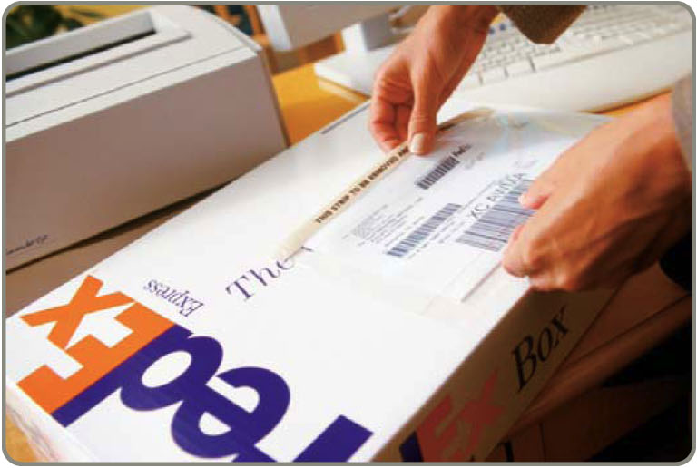
Third-Party Logistics
Outsourcing logistics can reduce costs and improve delivery reliability and speed
Coordinate supplier inventory with delivery services
May provide
warehousing,
assembly, testing,
shipping, customs

Slide 59
Cost of Shipping Alternatives
Product in transit is a form of inventory and has a carrying cost
Faster shipping is generally more expensive than slower shipping
We can evaluate the two costs to better understand the trade-off

Slide 60
Cost of Shipping Alternatives
Value of connectors = $1,750.00
Holding cost = 40% per year
Second carrier is 1 day faster and $20 more expensive
Annual holding cost
Daily cost of holding product
Product value
= x /365
= (.40 x $1,750)/ 365 = $1.92
Since it costs less to hold the product one day longer than it does for the faster shipping ($1.92 < $20), we should use the cheaper, slower shipper

Slide 61
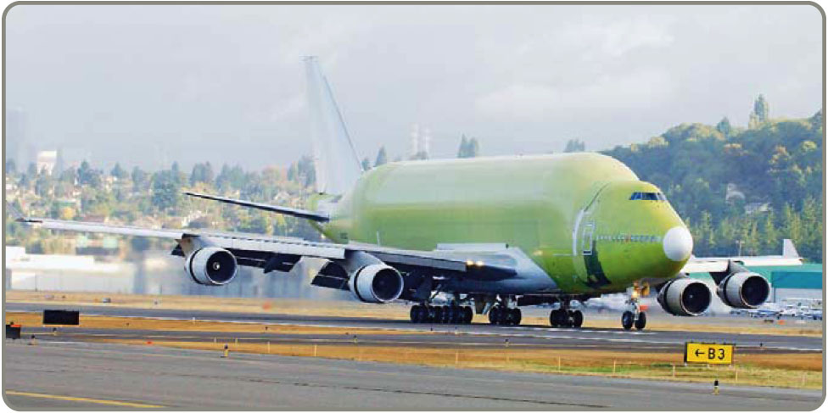
Security and JIT
Borders are becoming more open in the U.S. and around the world
Monitoring and controlling stock moving through supply chains is more important than ever
New technologies are
being developed to
allow close monitoring
of location, storage
conditions, and
movement

Slide 62
Measuring Supply-Chain Performance
 | Typical Firms | Benchmark Firms
Lead time (weeks) | 15 | 8
Time spent placing an order | 42 minutes | 15 minutes
Percentage of late deliveries | 33% | 2%
Percentage of rejected material | 1.5% | .0001%
Number of shortages per year | 400 | 4
Table 11.6

Slide 63
Measuring Supply-Chain Performance
Assets committed to inventory
Percent invested in inventory
Total inventory investment
Total assets
= x 100
Investment in inventory = $11.4 billion
Total assets = $44.4 billion
Percent invested in inventory = (11.4/44.4) x 100 = 25.7%

Slide 64
Measuring Supply-Chain Performance
Inventory as a % of Total Assets
(with exceptional performance)
Manufacturing 15%
(Toyota 5%)
Wholesale 34%
(Coca-Cola 2.9%)
Restaurants 2.9%
(McDonald’s .05%)
Retail 27%
(Home Depot 25.7%)
Table 11.7

Slide 65
Measuring Supply-Chain Performance
Inventory turnover
Cost of goods sold
Inventory investment
Inventory turnover
=

Slide 66
Measuring Supply-Chain Performance
Examples of Annual Inventory Turnover
Food, Beverage, Retail Manufacturing
Anheuser Busch 15 Dell Computer 90
Coca-Cola 14 Johnson Controls 22
Home Depot 5 Toyota (overall) 13
McDonald’s 112 Nissan (assembly) 150
Table 11.8

Slide 67
Measuring Supply-Chain Performance
Inventory turnover
Net revenue $32.5
Cost of goods sold $14.2
Inventory:
Raw material inventory $.74
Work-in-process inventory $.11
Finished goods inventory $.84
Total inventory investment $1.69

Slide 68
Measuring Supply-Chain Performance
Inventory turnover
Net revenue $32.5
Cost of goods sold $14.2
Inventory:
Raw material inventory $.74
Work-in-process inventory $.11
Finished goods inventory $.84
Total inventory investment $1.69
Cost of goods sold
Inventory investment
Inventory turnover =
= 14.2 / 1.69 = 8.4

Slide 69
Measuring Supply-Chain Performance
Inventory turnover
Net revenue $32.5
Cost of goods sold $14.2
Inventory:
Raw material inventory $.74
Work-in-process inventory $.11
Finished goods inventory $.84
Total inventory investment $1.69
Cost of goods sold
Inventory investment
Average weekly cost of goods sold
Inventory turnover =
= $14.2 / 52 = $.273
= 14.2 / 1.69 = 8.4
Inventory investment
Average weekly cost of goods sold
Weeks of supply =
= 1.69 / .273 = 6.19 weeks

Slide 70
The SCOR Model
Processes, metrics and best practices
Plan: Demand/Supply planning and Management
Source: Identify, select, manage, and assess sources
Make: Manage production execution, testing and packaging
Deliver: Invoice, warehouse, transport and install
Return: Raw material
Return: Finished goods
Figure 11.3

Slide 71

All rights reserved. No part of this publication may be reproduced, stored in a retrieval system, or transmitted, in any form or by any means, electronic, mechanical, photocopying, recording, or otherwise, without the prior written permission of the publisher.
Printed in the United States of America.

